Slide 1
Incidence of Child Labour and Child Schooling in India: Pattern and Determinants
Saswati Das
International Scholarly Research Network ISRN Economics Volume 2012
Discussion by:
Mirza Abdullah Kashif
Abdul Rehman Shoukat
Muhammad Usman
Najeeb ul Arafeen

Slide 2
Introduction:
Child labor leads loss of human capital and future chance of better earning
Child labor is high in developing countries (ILO), India ranks highest in the world
Empirical literature has shifted from quantification to econometric analysis.
Study aims to carry out supply side analysis to examine pattern of child labor and schooling to test regional and gender disparities
Objective of study is to have a policy that parents themselves withdraw their children from labor
Data is taken from National sample survey on “employment and unemployment situation in India” (2004-2005)

Slide 3
Child protection laws exist but there are ways to evade them
Child labor is less demanding, more obedient and require lower pay
80% of working children are Dalits
There was a positive relation between hours of child labor and poverty and a negative relation between child schooling and poverty
Previous work by Das and Mukherjee focused on urban children, but child labor is more of a rural phenomenon
Gender differentials, household characteristics, regional variations need to be considered

Slide 4
Methodology and Data:
Unit level data of National Sample Survey (NSS) for 61st round (2004-2005) on employment and unemployment have been used.
The survey period is divided into four sub-rounds
Each with duration of three months to capture the seasonal effect on employment opportunity.
The number of households surveyed was 79,306 in rural areas and 45,374 in urban areas.
Probit model has been used.

Slide 5
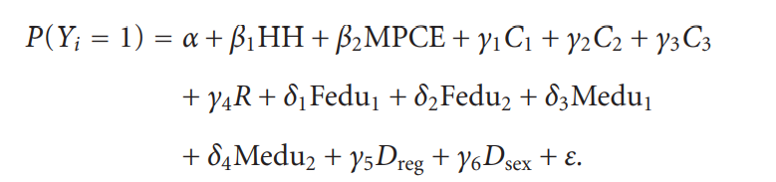
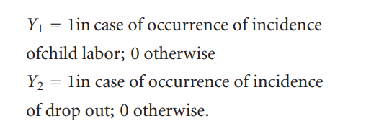
Regression Equation:
Var | Variable
HH | Household Size
MPCE | Average Monthly per capita expenditure
C₁ | Dummy for Scheduled tribe
C₂ | Dummy for Scheduled caste
C₃ | Dummy for other backward caste
R | Dummy for religion
Fedu₁ | Dummy for father’s education, “up to middle”
Fedu₂ | Dummy for father’s education, “above middle”
Medu₁ | Dummy for mother’s education, “up to middle”
Medu₂ | Dummy for mother’s education, “above middle;”
D_{reg} | 1 if observation from Rural, 0 otherwise
D_{sex} | 1 if child is female, 0 otherwise
ε | Error Term
Notes:
MPCE act as proxy for income
Taking not literate as reference category, two dummies, one for up to middle and another for above middle have been estimated.

Slide 6
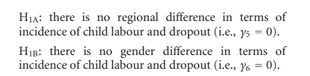
Hypothesis:
Notes:
Two aspects are being tested:
1 Effect of Region(Rural or Urban) on Child labor and Dropout
2 Effect of Gender in Child labor and Dropout

Slide 7
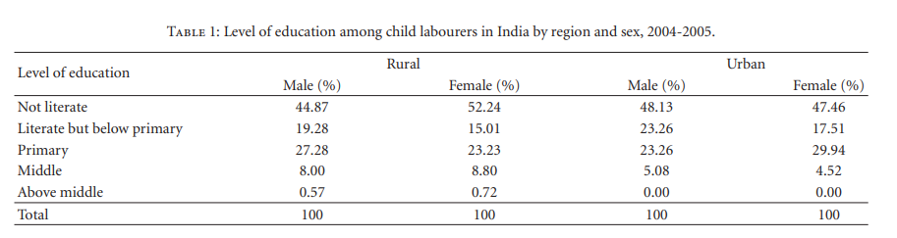
Notes:
It is distinctly clear from Table 1 that the dropout phenomenon sharply increases with level of education because as level of education increases the percentage of child laborers decreases. It can also be noted that incidence of dropout is more pronounced among urban children between primary and middle levels of education. It is possible due to diverse job opportunities in urban labour market

Slide 8
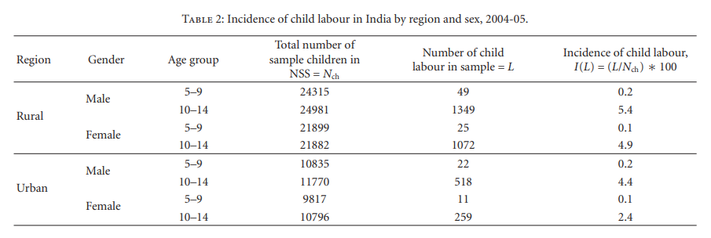
Notes:
Table 2 depicts the rates of incidence of child labour in India across region and sex for two common age groups, 5– 9 years and 10–14 years separately. The incidence rates are uniformly lower for the younger cohort than the older one. It can be noted that the girl children are less involved in wage economic activity, and hence they show up less in the labour (L) status. Consequently, incidence of child labour is higher for boys. Incidence of child labour in rural area is much higher than that of urban area.

Slide 9
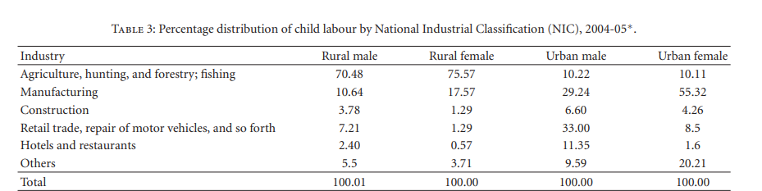
Notes:
This table shoes the pattern of child employment in various industries
A large number of children are engaged in agriculture, forestry, and fishing in rural sector
In URBAN They are engaged largely in enterprises, with male being in retail trade and females being in manufacturing
A moderately high percentage (about 11 per cent) is working in hotels and restaurants.

Slide 10
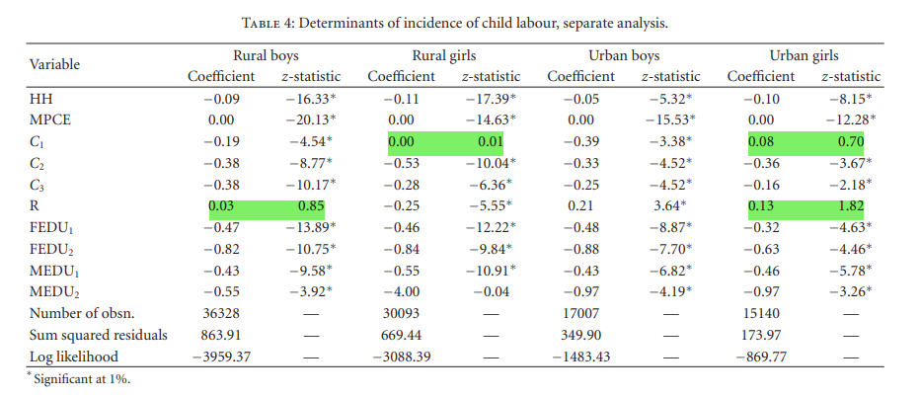
Notes:
MPCE and household size had a strong impact on both the decisions. education variables also have influence on these decisions.
Only for female children, scheduled tribe dummy is not significant (both in rural and urban) and religion dummy is not significant only for rural male and urban girl children.
It indicates the success of minority group targeted development policies adopted and implemented at the governmental level in India.

Slide 11
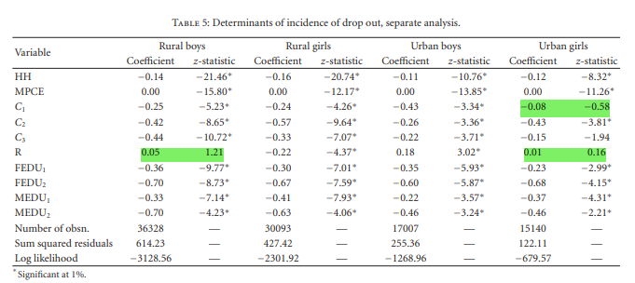
Notes:
This table discusses the determinants of incident of drop out
In this scheduled tribe for urban girls and religion for rural boys and urban girls is found to be insignificant

Slide 12
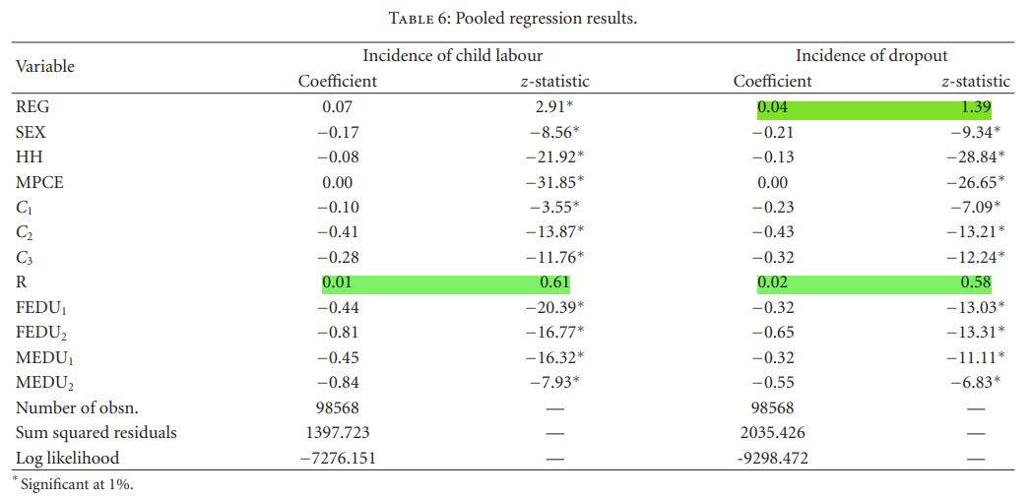
Notes:
Region is not significant in explaining the incident of dropout
And religion’s influence on child labor and drop out is also insignificant
If it’s a female child the z score decreases by the respected coeffircients CP
Except for region all variable decrease the z scrore as all coefficients are negative

Slide 13
Conclusion:
The study reveals that the issue of child labour is largely a rural phenomenon and it has significant gender implications.
The pattern of child employment in various industries reveals the failure of legal steps towards protecting them from occupational hazards.
Strong positive effect of parental education as well as income in reducing incidence of child labour and dropout.

Slide 14
Policy Recommendation
Work on reducing Poverty since child labor positively correlated
Improvement in school accessibility
Child labor is far more prevalent in Rural areas (Rural population --% of total population--- in Pakistan was 63.33 as of 2018) so address rural problems
increase social awareness, especially among the adult females
Implementation of laws: The Employment of Children Act 1991
Incentivize by free lunch, scholarships, extending ehsas program to education etc

Slide 15
THANK YOU!

